Slide 1
PhD Application Presentation
Simin Ma March 10, 2026
TU Dortmund University - Department of Statistics

Slide 2

About Me
Simin Ma
M.Sc. Data Science | TU Dortmund University
Experimental spirit · Collaborative researcher
Background
M.Sc. Data Science, TU Dortmund
B.Sc. Applied Statistics
Study Abroad, University of Malaya
Industry Experience
Intrum:
Data preprocessing for LLM applications
Heterogeneous records → standardised text workflow
Research Experience
TU Dortmund ls9 Group: UQ in Deep Learning
Reproducible Python/PyTorch workflow
TU Dortmund Project: Seminar
GAN Implementation,
convergence instability,
hyperparameter sensitivity
Experimental Pipeline

Slide 3
Master Thesis

Slide 4
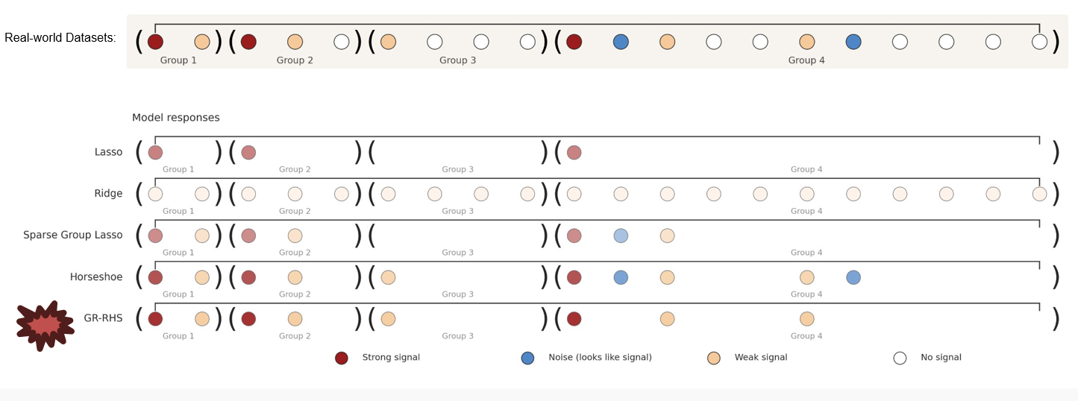
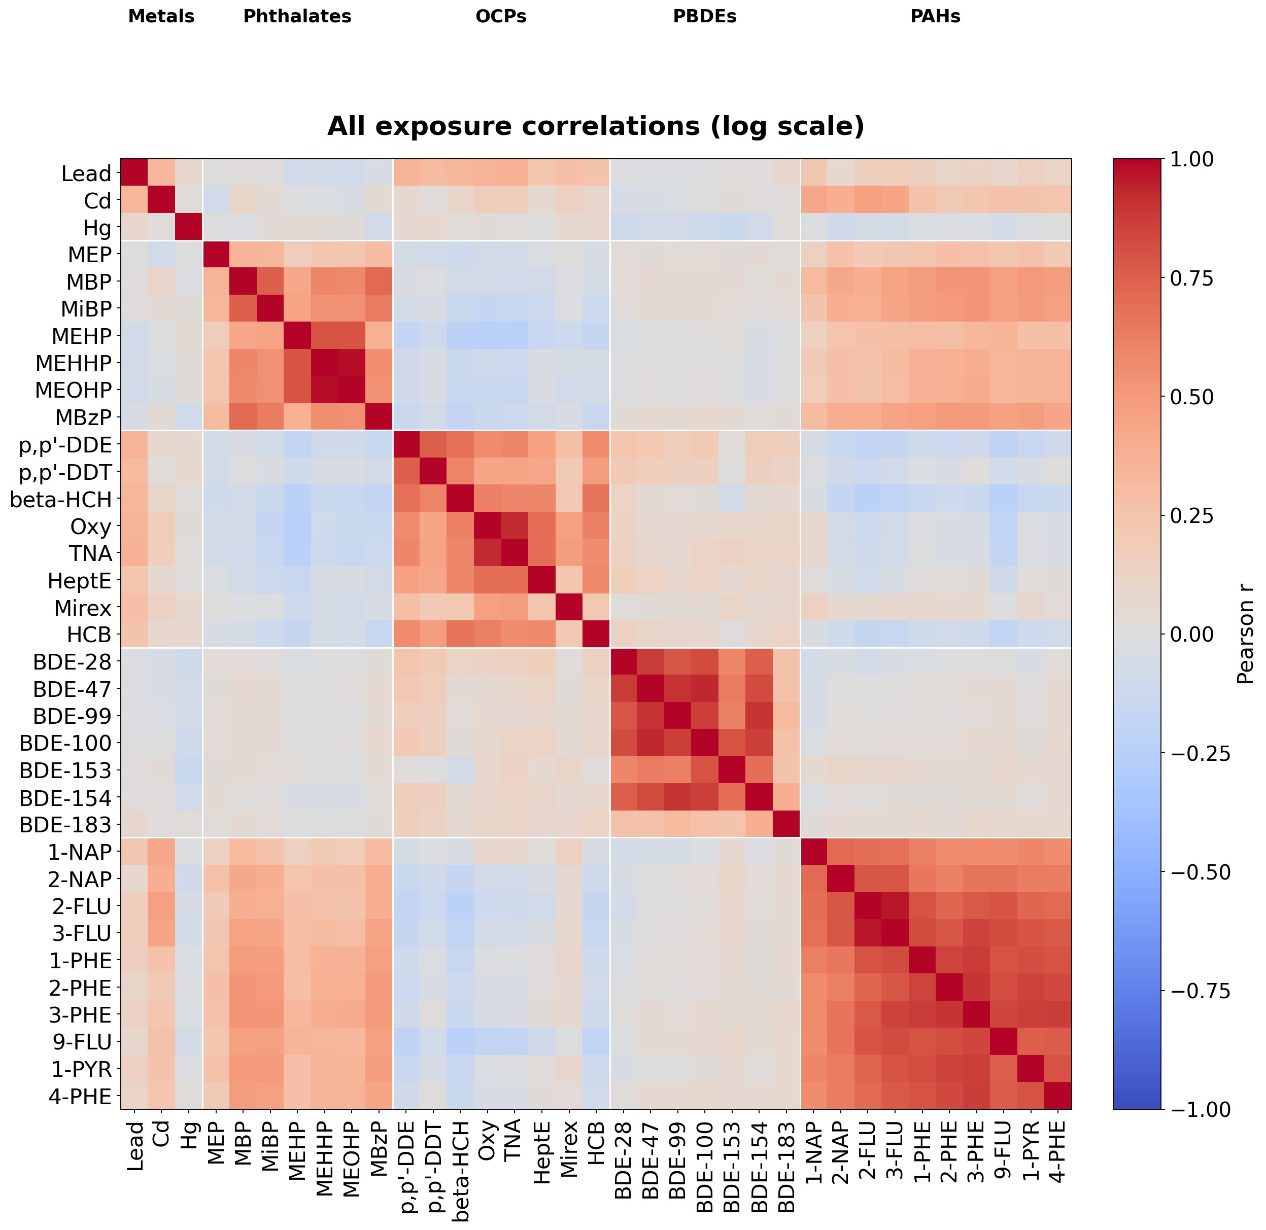

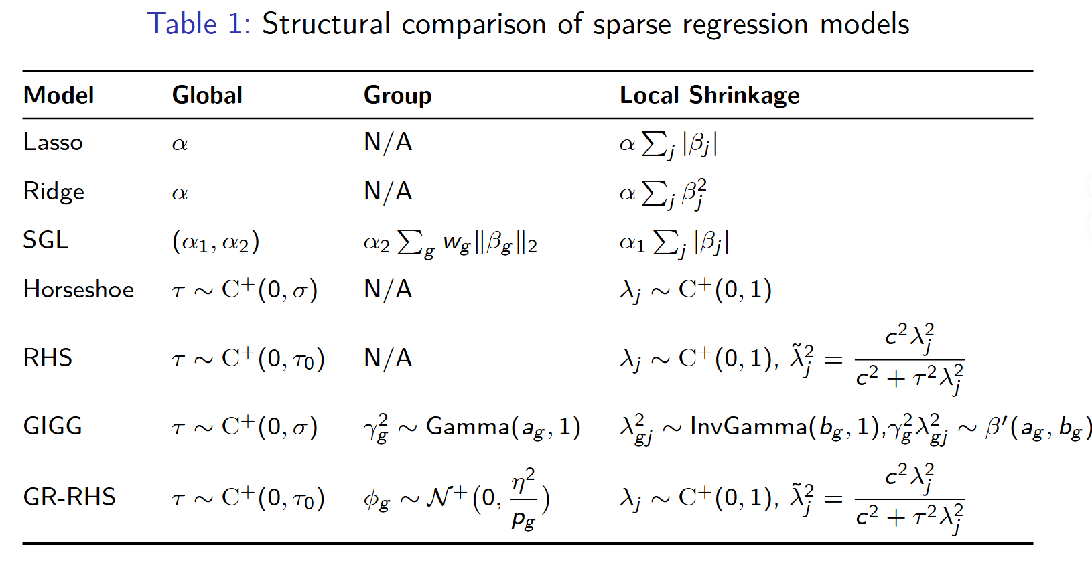

Intuitions behind the idea
The Group-Regularized Regularized Horseshoe (GR-RHS) Model for Mixed-Signal Regression.
What the Real-world Datasets looks like:
GR-RHS = Group Structure + Regularized Horseshoe
= Global * Group * Local Shrinkage
Notes:
D

Slide 5
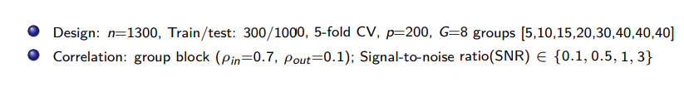
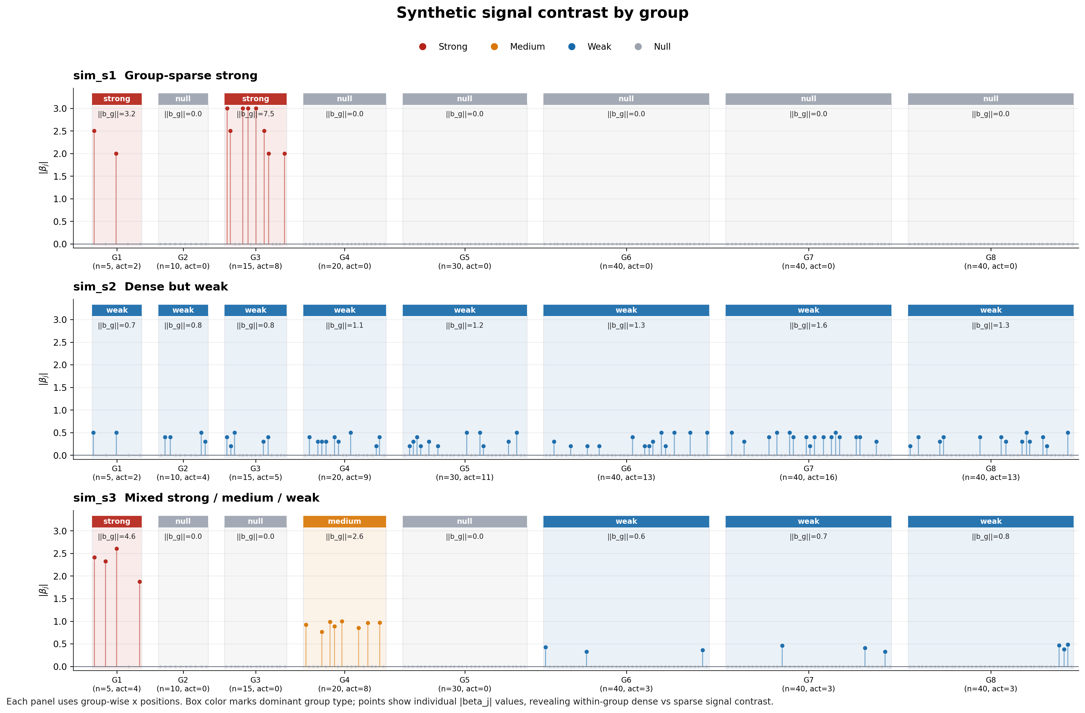
Experiments Design (Simulation Results)
Shared data & splits
Fair baseline
Fixed compute budget
Prior sensitivity check
Convergence consistency
Unified metrics
Reproducible configs

Slide 6
Experiments Design (Simulation Results)
Table 2: RMSE comparison
Scenario | SNR | GR-RHS | RHS | GIGG | SGL | Lasso | Ridge
S1 | 0.1 | 26.7382 | 27.1911 | 40.1707 | 24.7224 | 24.7534 | 25.0324
S1 | 0.5 | 12.0072 | 12.5457 | 17.7489 | 11.0136 | 11.2779 | 12.2130
S1 | 1.0 | 7.7705 | 8.6790 | 12.3657 | 7.8598 | 7.9754 | 9.4876
S1 | 3.0 | 4.9045 | 4.9841 | 6.7307 | 4.5205 | 4.6106 | 5.8996
S2 | 0.1 | 10.9243 | 10.9953 | 17.2614 | 11.2270 | 11.2453 | 11.2105
S2 | 0.5 | 5.5266 | 5.6159 | 7.2790 | 5.5470 | 5.5844 | 5.5284
S2 | 1.0 | 4.1304 | 4.3570 | 4.9846 | 4.1893 | 4.2769 | 4.2845
S2 | 3.0 | 2.7381 | 2.7385 | 2.8270 | 2.6890 | 2.7571 | 2.6789
S3 | 0.1 | 18.3627 | 17.2453 | 29.2454 | 16.6957 | 16.9668 | 17.0547
S3 | 0.5 | 7.6227 | 7.7513 | 12.7004 | 7.6557 | 7.8260 | 8.3502
S3 | 1.0 | 5.2247 | 5.7138 | 8.6687 | 5.5066 | 5.6145 | 6.4537
S3 | 3.0 | 3.1485 | 3.2738 | 4.3568 | 3.3006 | 3.3057 | 4.0716

Slide 7
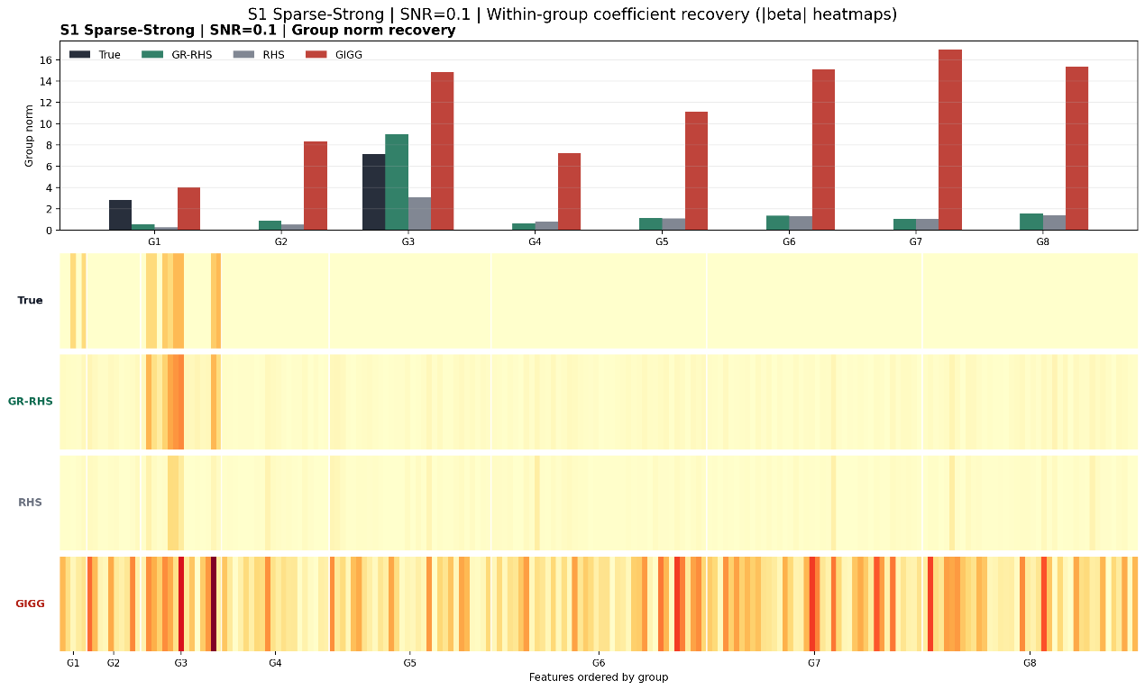
Experiments Design (Simulation Results)
Do they really recover?

Slide 8
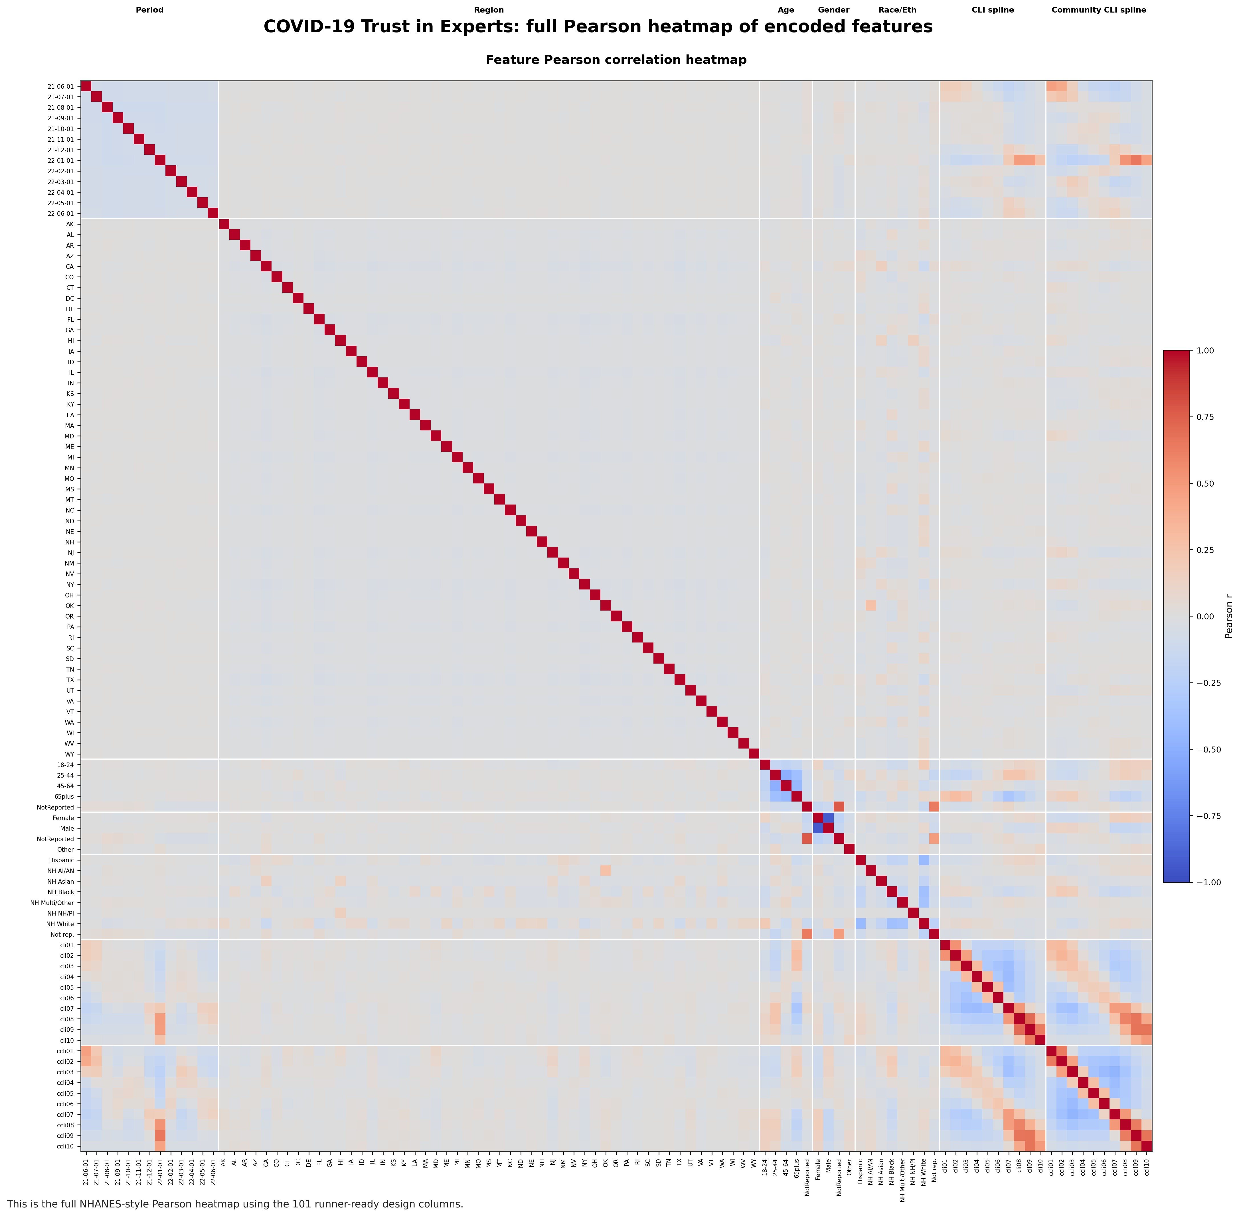
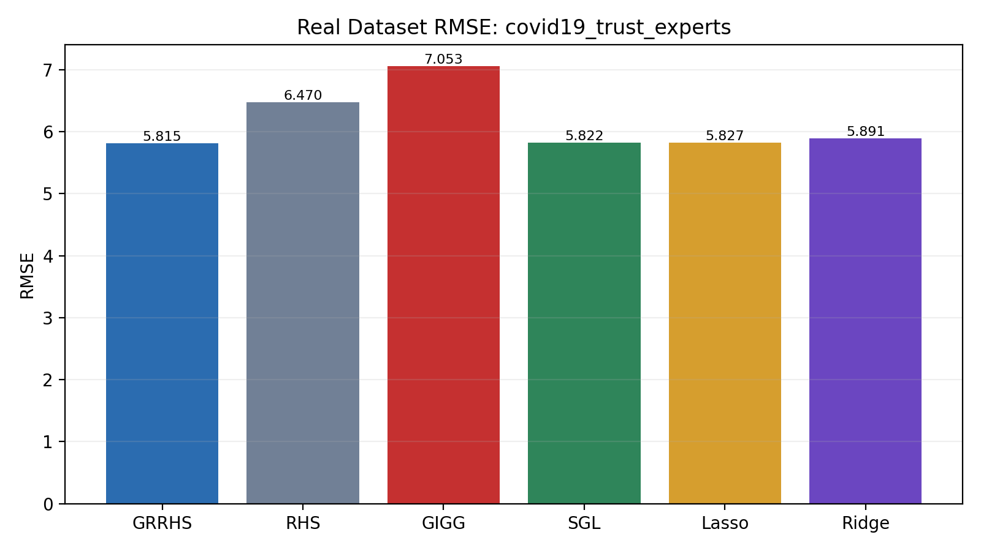
Experiments Design (Real Datasets)
•

Slide 9
Research Interests

Slide 10
Curious about...
Attention is all you need. But cuda is out-of-memory.
- Everything is about Trade-Off.
- Can I trust them?
- Can it be more user-friendly?
Beautiful things don’t ask for attention.

Slide 11
Thank you for listening and for the opportunity to present!

